Slide 1


Find trustable NGO for donation using machine learing

Slide 2
Group members
SUPERVISED BY
DR. ASHRAF UDDIN
Assistant Professor, CS
AMERICAN INTERNATIONAL UNIVERSITY-BANGLADESH
NAME ID
MD. MEHEDI HASAN 22-46322-1
ABDUL KADER ZELANI 22-47165-1

Slide 3

Outline
Introduction
Problem Statement
Objectives
Literature Review and Analysis
Methodology
Experimental Results
Comparative Analysis
Outcome and Impacts
Conclusion and Future Works

Slide 4
Introduction
In today's interconnected world, trust plays a vital role in meaningful relationships .It ensuring the reliability of organizations. For a donation organizations, trust means people believe they are reliable, honest, and capable. Without trust, it’s hard to create meaningful connections with them.
Our project identifies trustable organizations or NGOs using machine learning.
Evaluate key indicators like age, Fund Utilizeratio, Public Rating (1-5), Social Media Followers, and location.
Promotes informed decision-making.
This project is important because it promotes transparency and trust in the NGO sector by providing an objective, scalable, and data-driven system to evaluate trustworthiness.
It eliminates bias and encourages accountability, and ensures better allocation of resources.

Slide 5
Problem Statement
The way we evaluate whether an organization is trustworthy is often inconsistent and depends too much on personal judgment.
Lack of standardized methods to assess trustworthiness using data-driven techniques.
Manual evaluations are resource-intensive and prone to bias.
Need for a robust, scalable system to identify reliable organizations effectively.

Slide 6
Research Questions
How can machine learning models effectively predict the trustworthiness of NGOs based on key operational and public perception metrics?
What are the most influential factors in determining NGO trustworthiness?
Which machine learning model provides the best balance of accuracy, precision, and recall for trustworthiness prediction?
Can incorporating additional features (e.g., financial transparency, geographical reach) enhance prediction accuracy?

Slide 7
Objectives
The objective of this project is to develop a system to evaluate the trustworthiness of NGOs. This system aims to:
Develop a machine learning-based system to identify that organizations as trustable or not.
Compare the performance of various machine learning algorithms like Random Forest with Hyperparameter Tuning, Logistic Regression and K-Nearest Neighbors (KNN).
NGOs and decision-makers can improve their trustworthiness and make informed decisions.
Validate the model using realistic datasets.

Slide 8

Literature Review and Analysis
Research Findings
Random Forest models show high accuracy in classification tasks.
KNN: Competitive but sensitive to scaling.
Key Predictors:
Public Rating: A strongest indicator of trustworthiness.
Fund Utilization Ratio: High impact on predictions.
Social Media Follower Count: Correlated with public trust.Early defect detection techniques and algorithm comparisons emphasize model selection.
Evaluation: Random Forest achieved the lowest false negatives and highest precision/recall scores.

Slide 9
Literature Review and Analysis
Research Gaps and Limitations
Limited exploration of Artificial Neural Networks (ANNs).
Lack of diversity in datasets.
Need for comprehensive performance comparisons between algorithms.

Slide 10
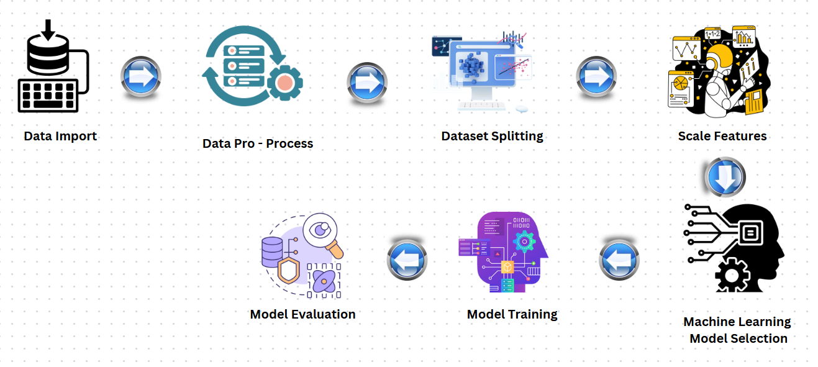
Methodology
Working Process
Fig. 01: Workflow

Slide 11
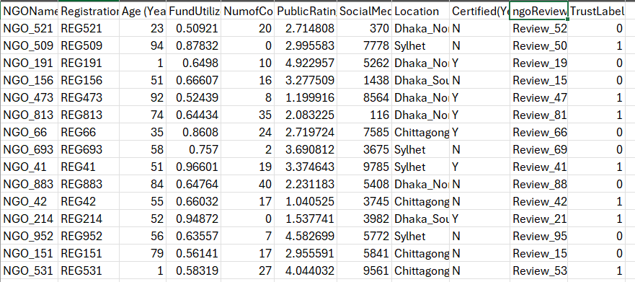
Methodology
Dataset Description
Dataset: Synthetic NGO dataset with features like name, age, fund utilization ratio, public rating, and location.

Slide 12

Methodology
Machine Learning Algorithms
Chosen machine learning algorithms:
Random Forest : Combines the output of multiple decision trees to make predictions. It is used to predict the trustworthiness of NGOs while ensuring robust, accurate, and reliable results.
Logistic Regression : Predicts the probability of a categorical dependent variable using a logistic/sigmoid function. Logistic Regression acts as a baseline model to evaluate the effectiveness of other, more complex algorithms.
K-Nearest Neighbors : Classifies a data point based on the majority vote of its nearest neighbors in feature space. KNN is used to provide an additional perspective by relying on distance-based classification.

Slide 13
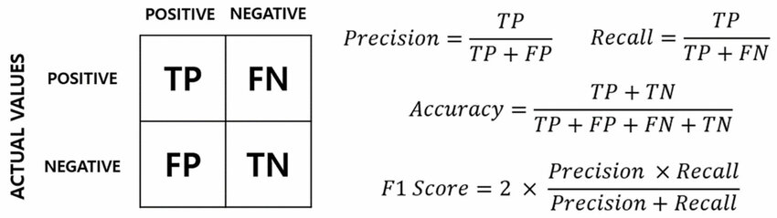
Methodology
Application of evaluation metrics
Confusion Matrix,
Accuracy,
Precision,
Recall.
Fig. 02: Confusion Matrix

Slide 14
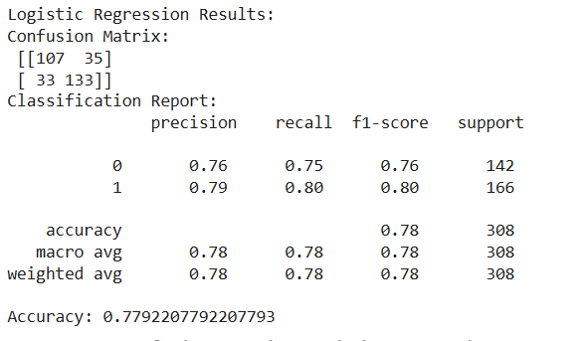
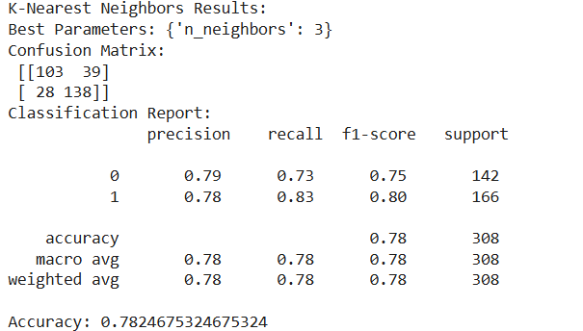
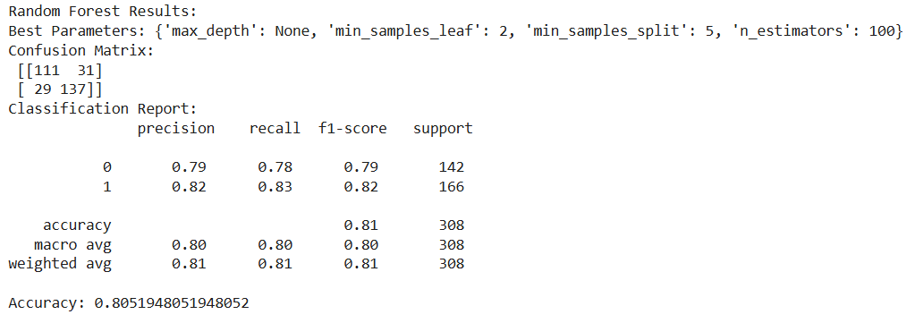
Experimental Results
Random Forest:Best Accuracy: 81%High precision and recall.
Logistic Regression:Accuracy: 78%Balanced and interpretable results.
KNN:Accuracy: 78%Competitive with tuned parameters.

Slide 15
Comparative Analysis
Random Forest(Accuracy: 81%) outperformed Logistic Regression and KNN in most metrics due to its ensemble nature and robustness.
Logistic Regression (Accuracy: 78%)provided faster predictions but lacked complexity for higher accuracy.
KNN(Accuracy: 78%) also provide a balanced performance .
With 81% Accuracy the Random Forest model as the most suitable choice for predicting NGO trustworthiness effectively and reliably.

Slide 16

Outcomes and Impacts
Reliable trust evaluation using machine learning models.
Random Forest as the most effective model.
Validated methodology on synthetic NGO data.
Encourages transparency and accountability.
Supports decision-making for users .

Slide 17
Conclusion and Future Works
Machine learning models enhance trust evaluation processes.
Random Forest emerged as the most effective model for this task.
Incorporate real-world datasets.
Explore advanced ensemble techniques.
Develop user-friendly platforms for practical applications.

Slide 18
Thank You!

